Slide 1
Kruskal and Reverse-Delete
Ron Gunczler, Kevin Wallace, Jonathan Wu

Slide 2
Algorithm Purpose/Problem Statement
A minimum spanning tree is the subset of the edges of a connected undirected graph that connects all the vertices, without any cycles.
Input - Connected graph with varying amount of edges
Output - Minimum spanning tree
Formatted as edge connecting two nodes and weight

Slide 3
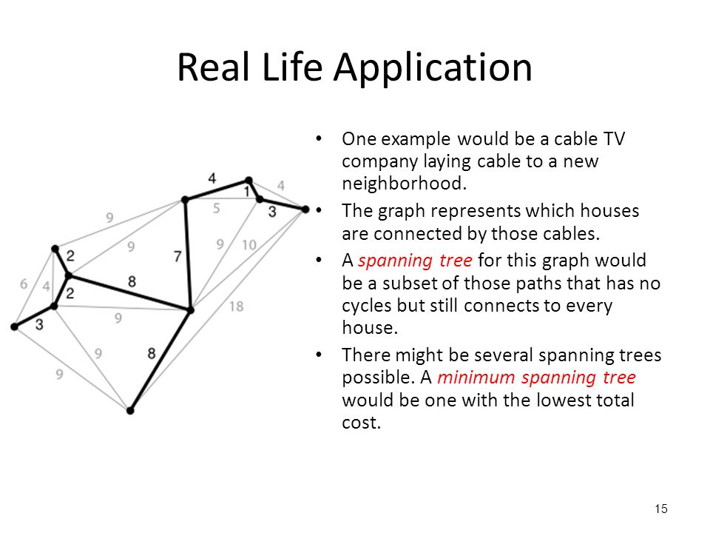

Slide 4
Kruskal’s Algorithm
Sort all edges in non-decreasing order by weight
Pick the smallest edge:
If it forms a cycle with the current spanning tree, discard
If no cycle is formed add the edge
Repeat step 2 until there are (V-1) edges in the spanning tree

Slide 5
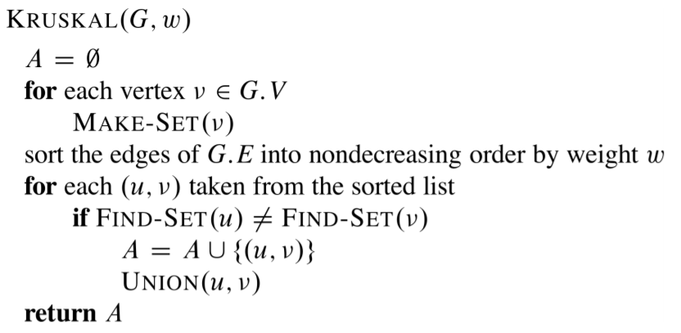
Pseudocode
Kruscal(Graph)
A = empty set
For each vertex in Graph: make-set(vertex)
Sort edges in non-decreasing order

Slide 6
Reverse-Delete Algorithm
Sort edges in reverse order
Go through edges, check if deleting the edge disconnects the graph
If it disconnects, do not delete
If the graph still connects, delete
Perform any deletion until all edges cannot be deleted

Slide 7
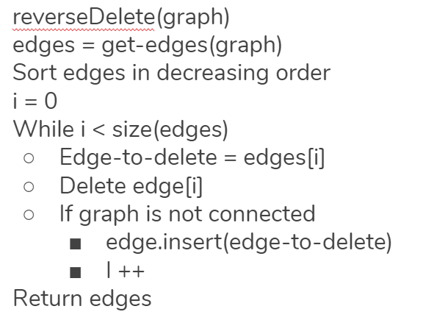
Pseudocode

Slide 8
Kruskal-Analysis
Time complexity O(E log E) = O(E log V), where E = # edges, V = # vertices
E is at most V² and log(V²) = 2log(V) = O(logV) = O(logE)
Sorting takes O(E logE)
We then use the union find data structure to put verticies into groups.
You then perform at least V operations to connect the tree union-find (disjoint-set) can merge the groups in amortized O(n) and can search for elements in amortized O(n)
The total time is O(E logE) + O(V) = O(E logE) = O(E logV)

Slide 9
Reverse-Delete Analysis
Time complexity O(E logV(log log(V))³)
Sorting takes O(E log E) which can simplify to O(E log V)
E iterations of the loop
Deleting an edge, checking if the graph is connected, and re-inserting can be done in O(log V(log logV)³) per operation

Slide 10
Implementation
Used C++
Adjacency list and adjacency matrix Graphs
Edge and Node classes
Disjoint set data structure

Slide 11
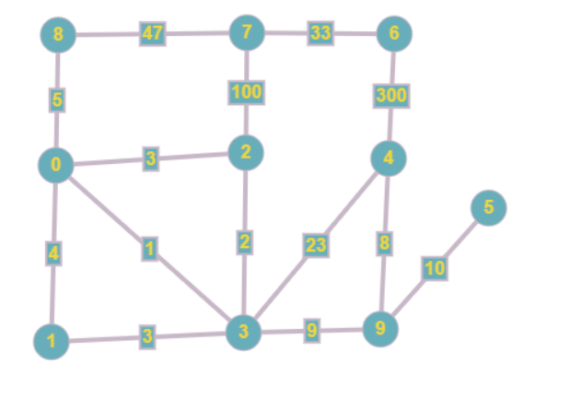
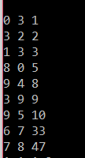
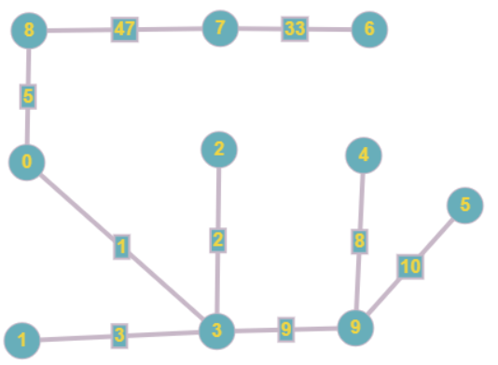
Demo
Kruskal’s

Slide 12
Experimental Plan
Data Set
Generate random number R between 1 and N and make that many Nodes
Generate random number between (R-1) and (R)(R-1)/2 and create that many Edges
Run this process 10 times where each repeat doubles N

Slide 13
Conclusion - Results
Kruskal’s algorithm is quicker because of the time complexity
Reverse-delete has an extra constant of (log log V)³ which makes it slower
Our reverse-delete implementation is not ideal

Slide 14
Conclusion - Limitations and Future Work
Reverse-delete takes longer than expected due to our implementation
When deleting an edge, a new graph is copied and a BFS is called on the new graph to see if it is still connected
The creation of a new graph makes reverse-delete run noticeably longer

